Slide 1
Public Health Case Study:
Tracking Zombies and Vampires using Social Media
John Feland, CEO and Founder
john.feland@argusinsights.com
http://www.argusinsights.com
@argusinsights, #strataconf, #zompire
27 Feb 2013

Slide 2
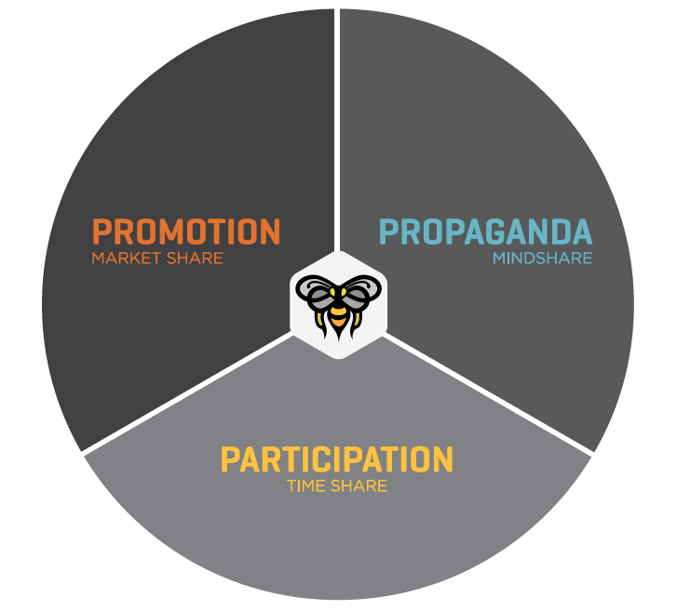
Best Practices from Social Campaigns

Slide 3
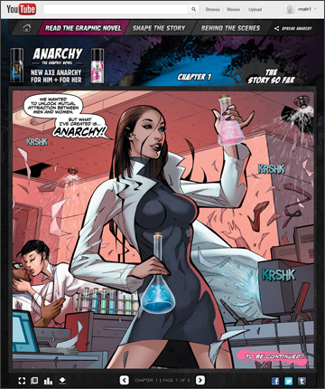
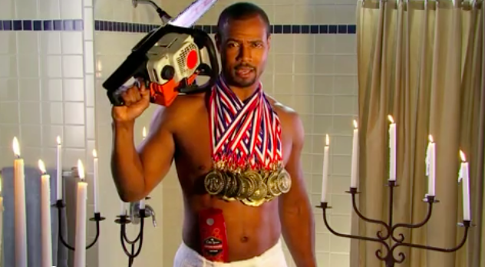
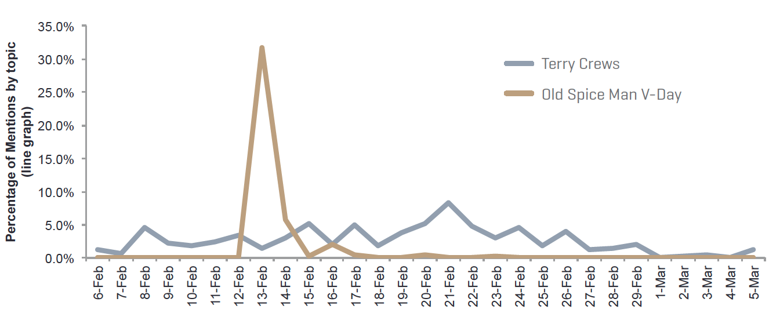
Lots of chatter but few conversations
“Dear axe body spray, please out a suggested serving size on your bottle. Sincerely, choking girls everywhere.”
“Nothing says ‘I love you’ like a man’s armpit wearing Old Spice inside of a tuxedo on a battleship that has a mariachi band to serenade you.”

Slide 4

But who is engaging?

Slide 5
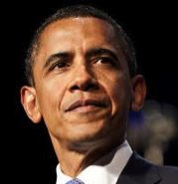
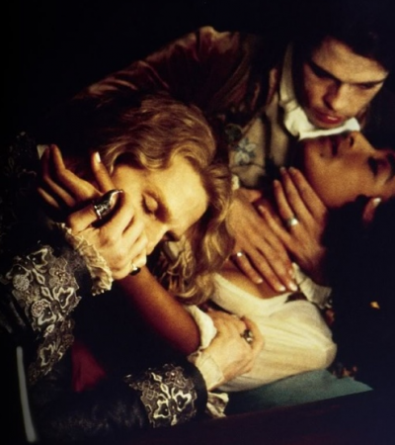
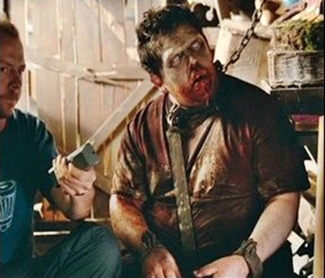
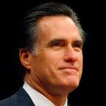
VS

Slide 6
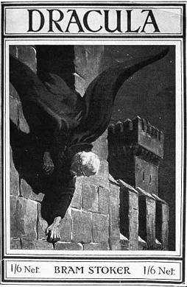
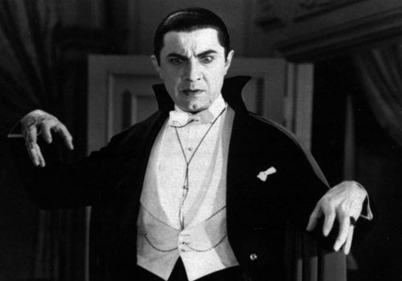
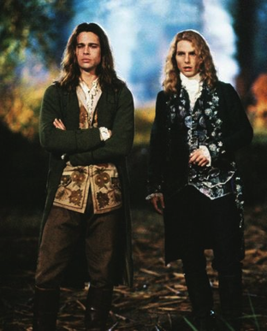
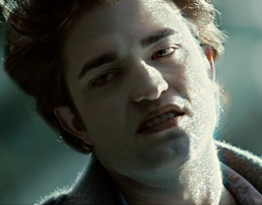

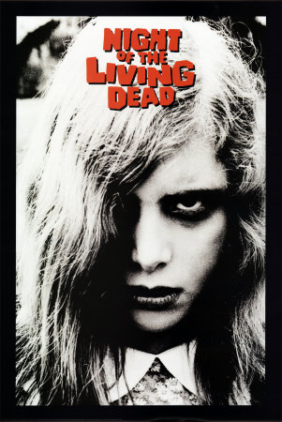
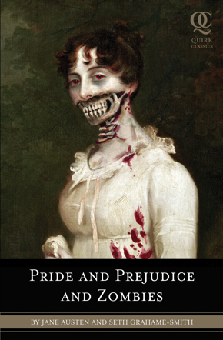
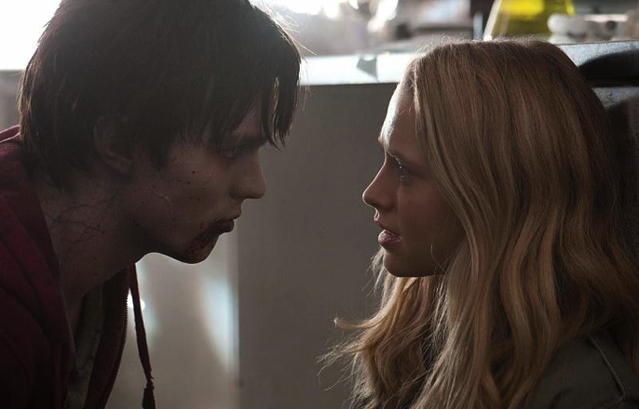
Humankind has been fascinated for centuries!

Slide 7
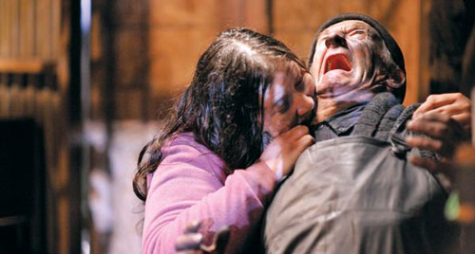
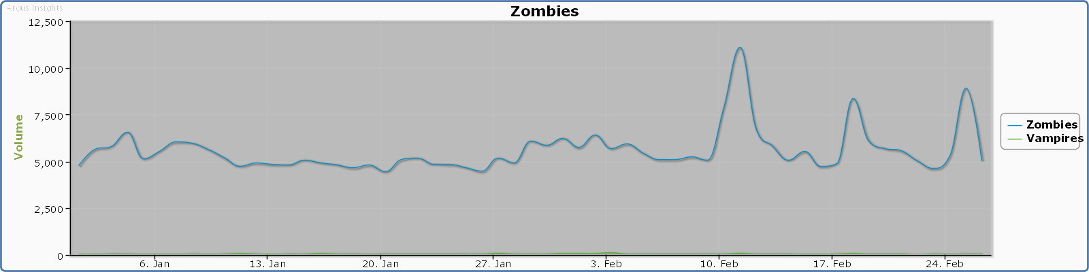
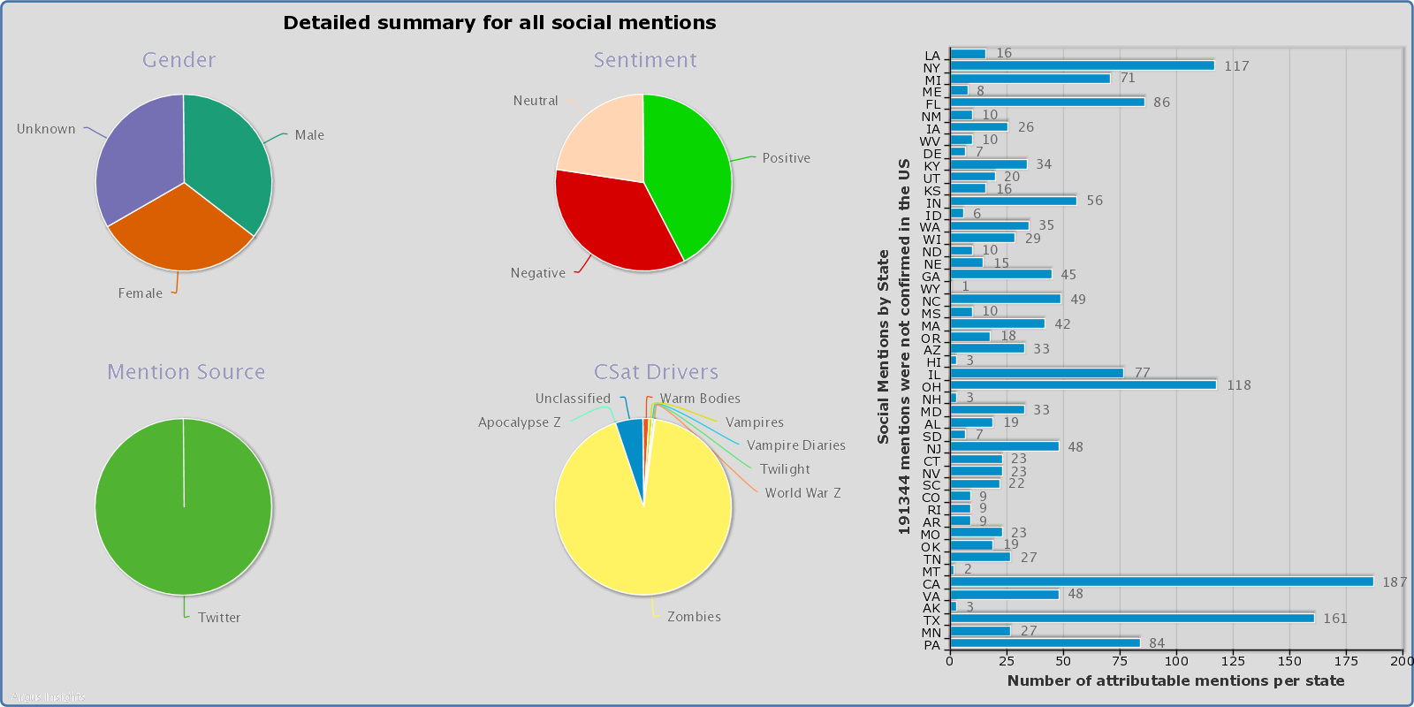
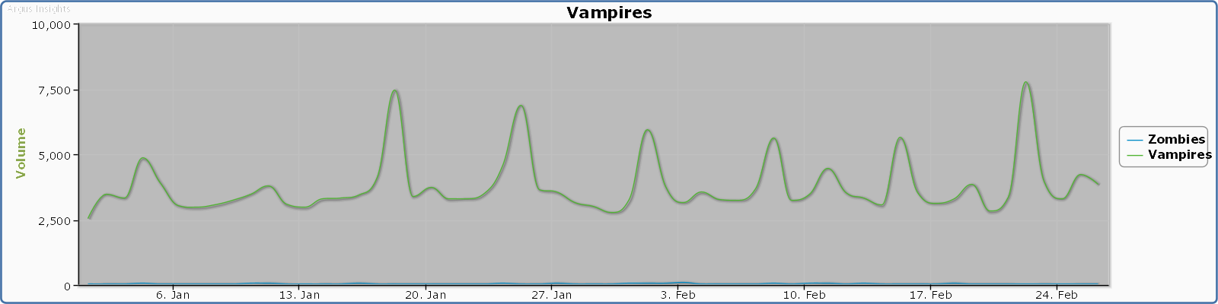
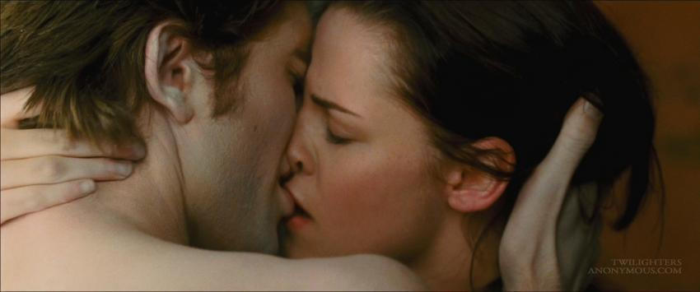
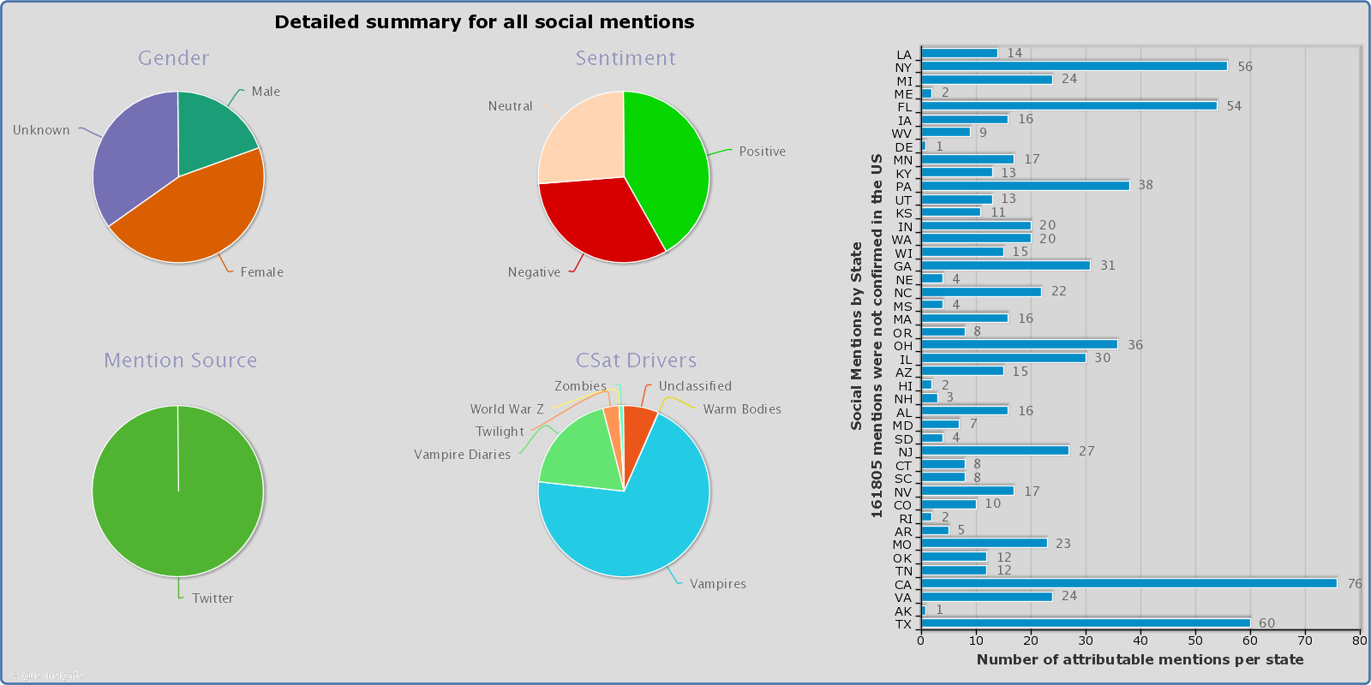
Tracking Target Segments since Oct 2012 in Twitter
Walking Dead Premiere
Zombies are gender balanced. Twice as many women mention vampires
Zombie Chatter is steadily 2X that of Vampire Chatter
Vampire Diaries Premiere
Notes:
10% of total mentions
Filters constructed to focus not on brands, shows, movies but pure mentions of vampires and zombies
Vampires 476596 tweets
Zombies 715615 tweets

Slide 8
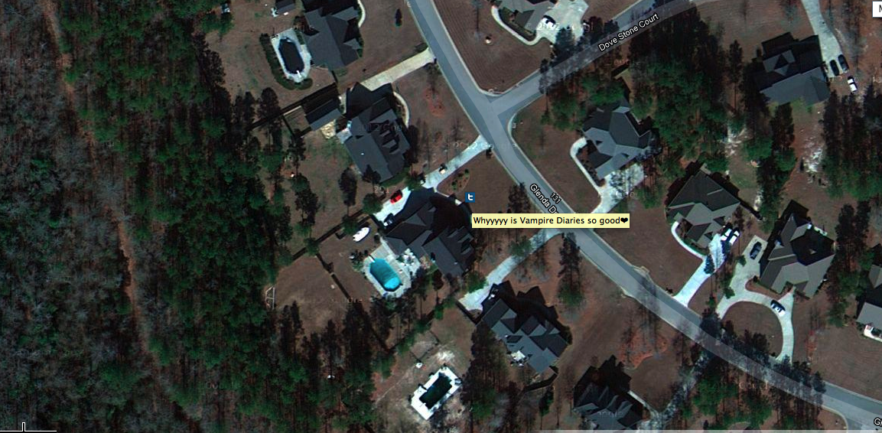
Somewhere in suburban Georgia
Notes:
1897 Dracula
2009 P,P and Z
Twilight 2005

Slide 9
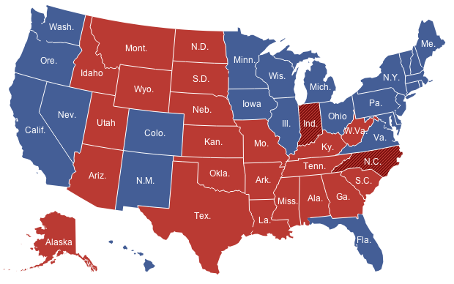
Introducing the Zompire Index
Needed a way to track the both targets
Normalized for state populations to understand relative strength of segment
Since one target is larger than the other needed a way to balance

Slide 10
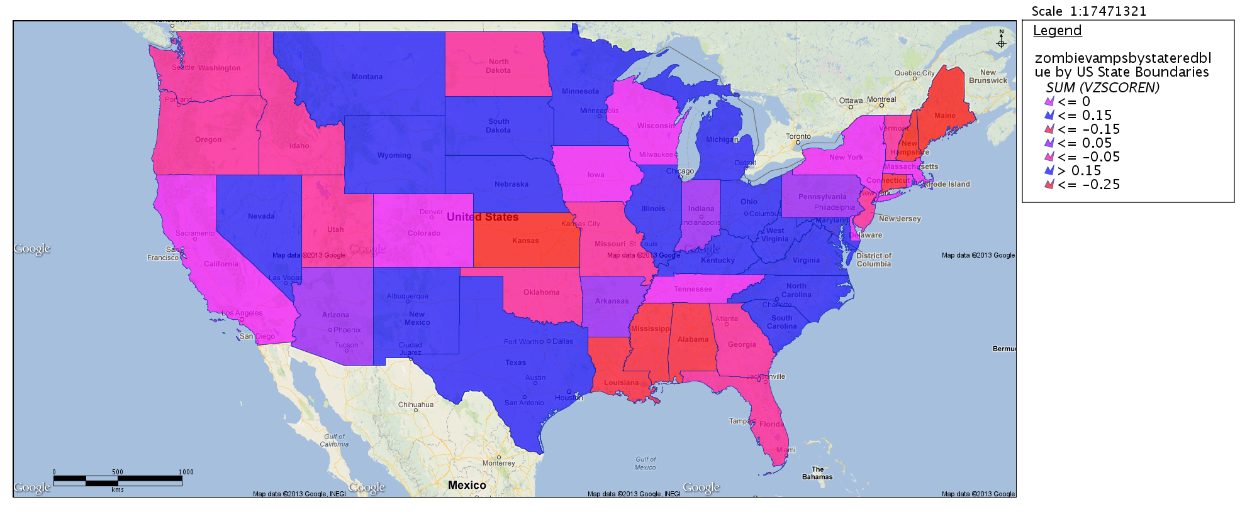
Visualizing the Balance of Power across Target Segments

Slide 11
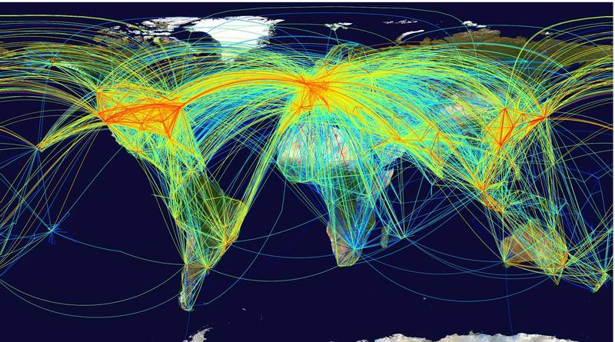
Subsegment Characterization (Vectors of Infection!)
Zombie Apocalypse |  | Walking Dead |  | Black Ops |  | Last Night |  | Warm Bodies
Alaska | 2.73 | Arkansas | 1.36 | West Virginia | 1.08 | Maine | 0.75 | Rhode Island | 2.86
Virginia | 2.44 | Montana | 0.99 | Rhode Island | 0.95 | Hawaii | 0.72 | South Dakota | 1.20
Missouri | 2.32 | Idaho | 0.63 | Maryland | 0.85 | Kansas | 0.69 | Colorado | 0.96
New Hampshire | 2.27 | Colorado | 0.58 | Indiana | 0.76 | Maryland | 0.68 | Conn | 0.84
Utah | 2.10 | Conn | 0.56 | Nevada | 0.72 | West Virginia | 0.54 | Maine | 0.75
Vampire Diaries |  | Vampire Slayer |  | Abraham Lincoln Vampire Hunter |  | Vampire Weekend |  | Last Night
North Dakota | 5.72 | Vermont | 1.60 | West Virginia | 1.08 | Rhode Island | 0.95 | Iowa | 0.98
West Virginia | 3.23 | Rhode Island | 0.95 | Indiana | 0.76 | Colorado | 0.39 | Indiana | 0.31
Iowa | 2.93 | New Hampshire | 0.76 | Nevada | 0.36 | Nevada | 0.36 | Conn | 0.28
Utah | 2.80 | Kentucky | 0.68 | Kansas | 0.35 | Utah | 0.35 | New York | 0.26
Minnesota | 2.79 | Oklahoma | 0.52 | Arkansas | 0.34 | Oklahoma | 0.26 | Illinois | 0.23
Mississippi | 2.68 | Indiana | 0.46 | New Jersey | 0.34 | Ohio | 0.26 | Arizona | 0.15

Slide 12
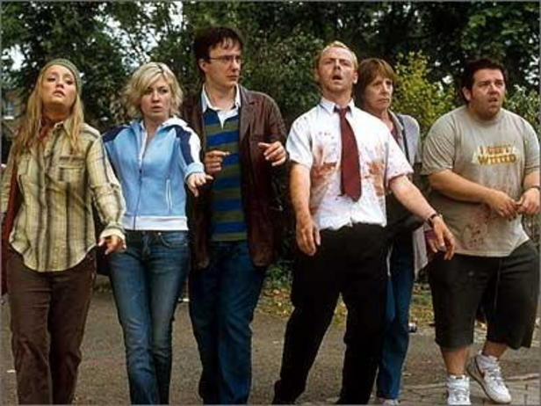
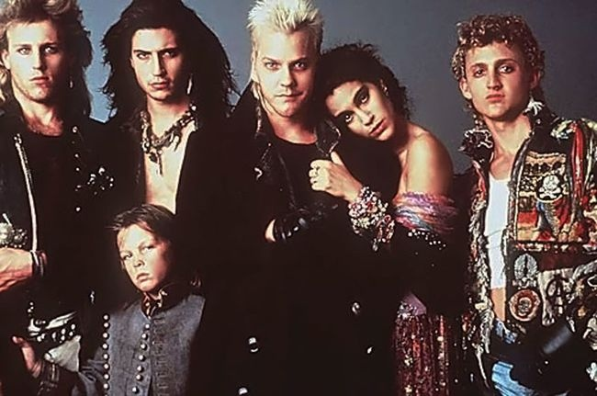
But who are these legions of the undead?
?
?
?
?
?
?
?
?
?
?
?
?

Slide 13
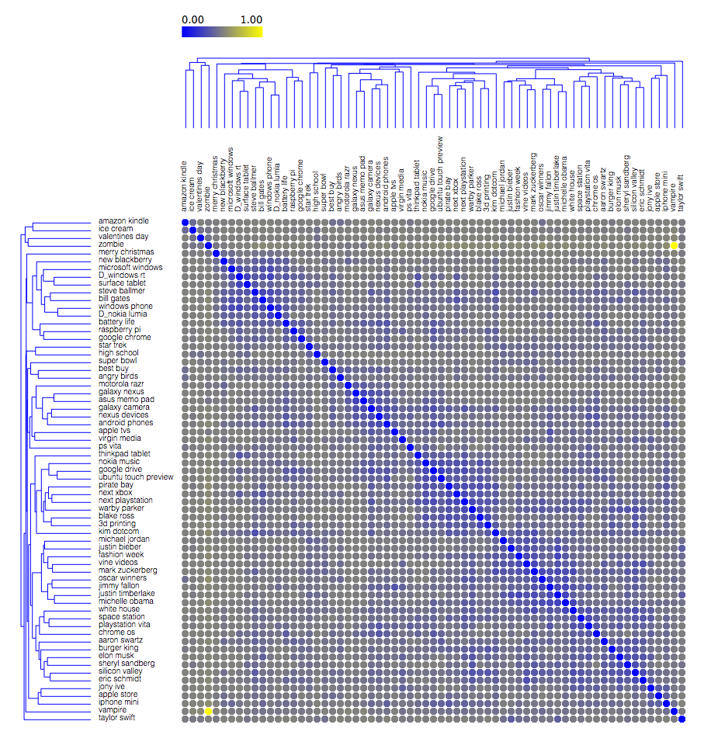
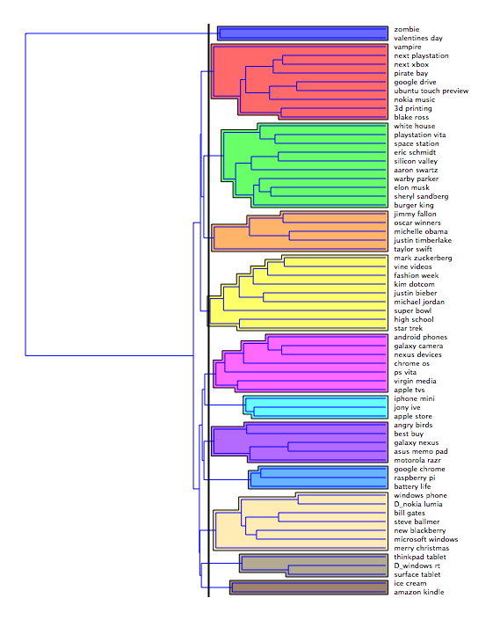
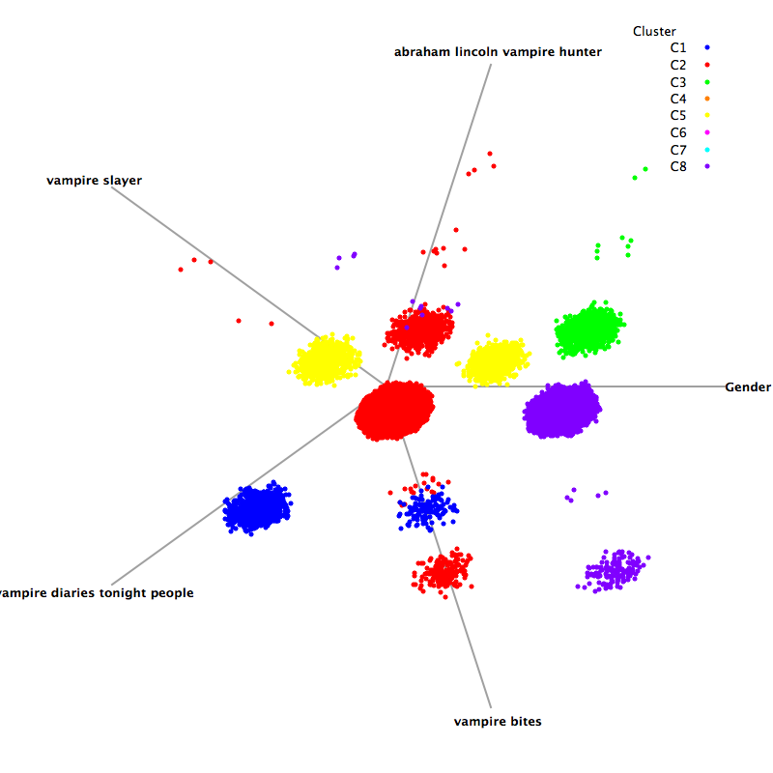
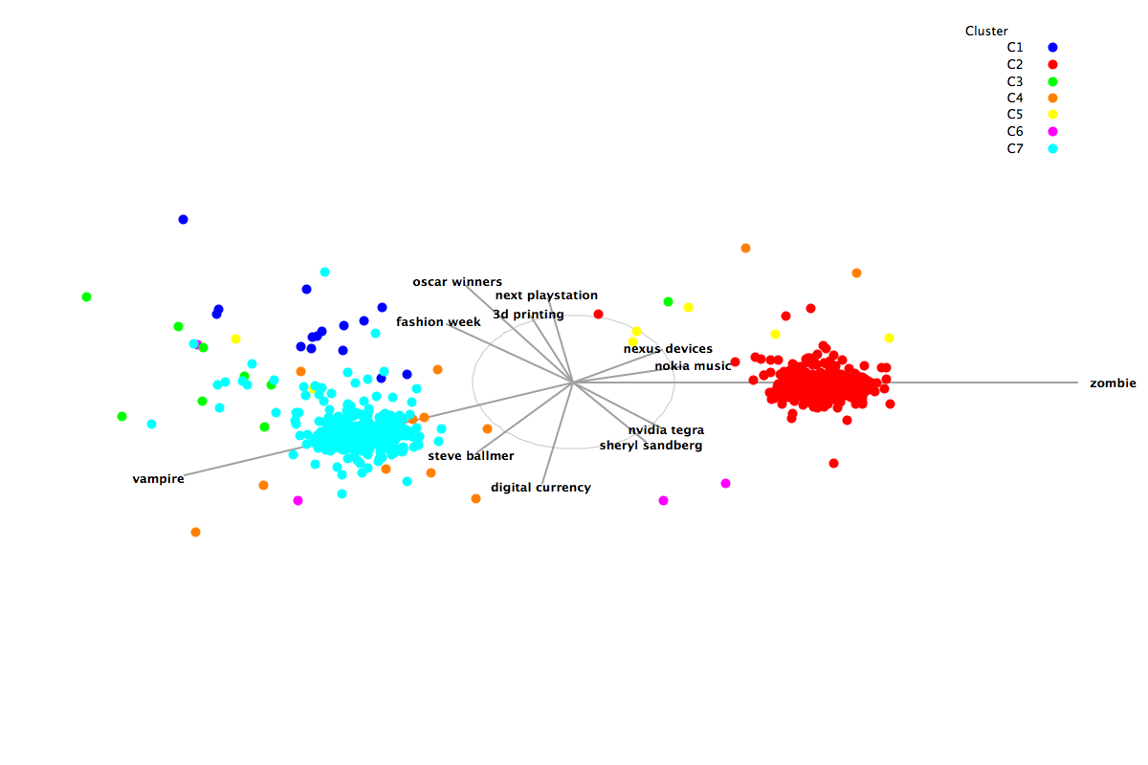
Cluster, cluster, who’s got the cluster?

Slide 14


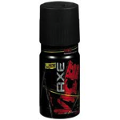



“If I can’t understand it in 20 sec, I won’t buy it”
Zombie Biased Topics
Zompire
Shared Topics
Vampire Biased Topics

Slide 15
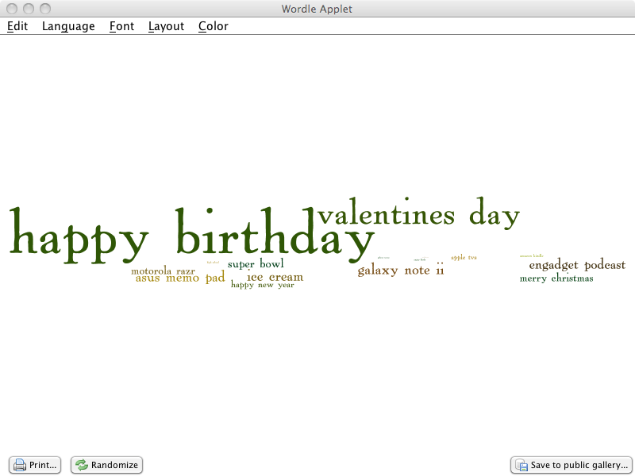
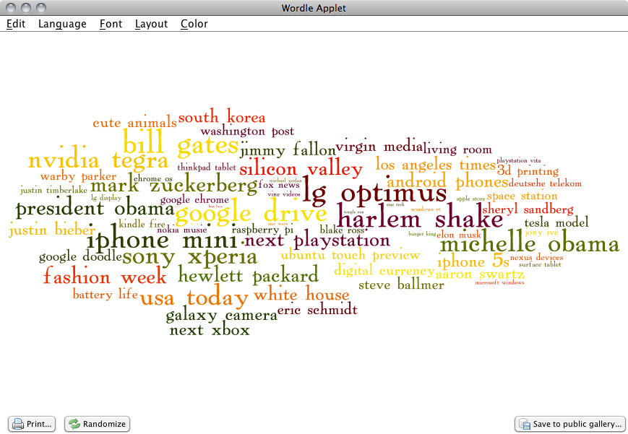
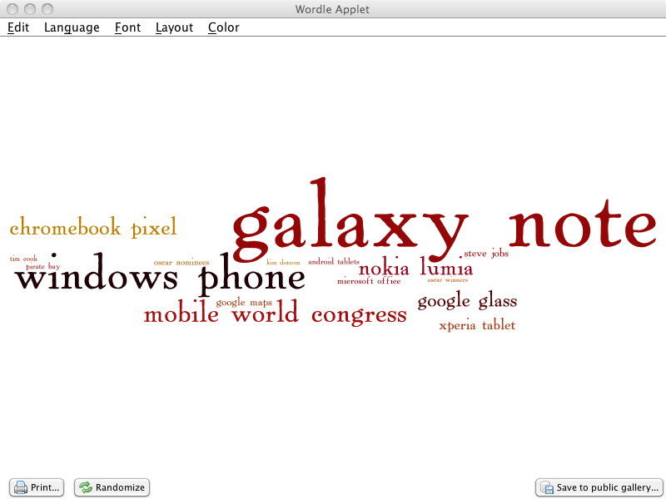
General Sampling of Target Segment

Slide 16
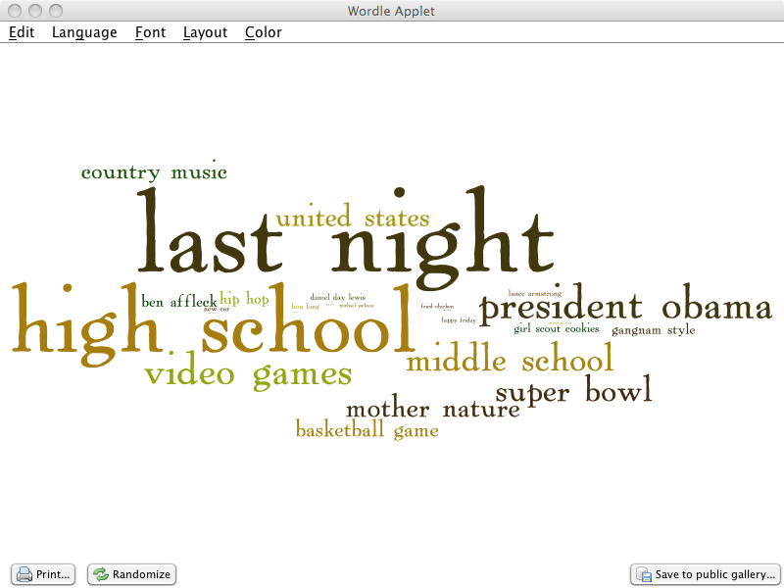
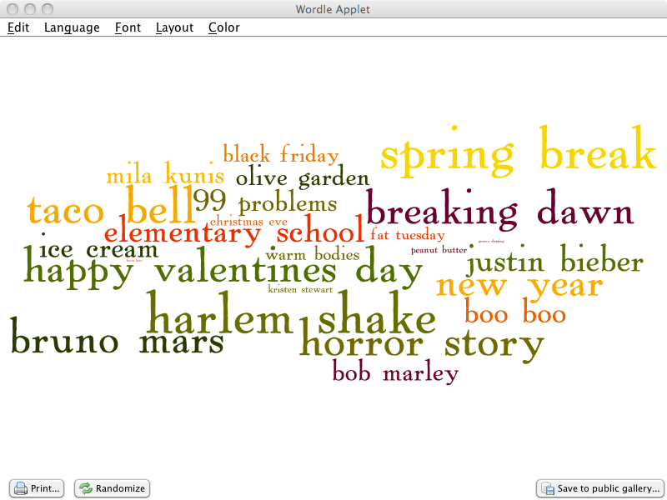
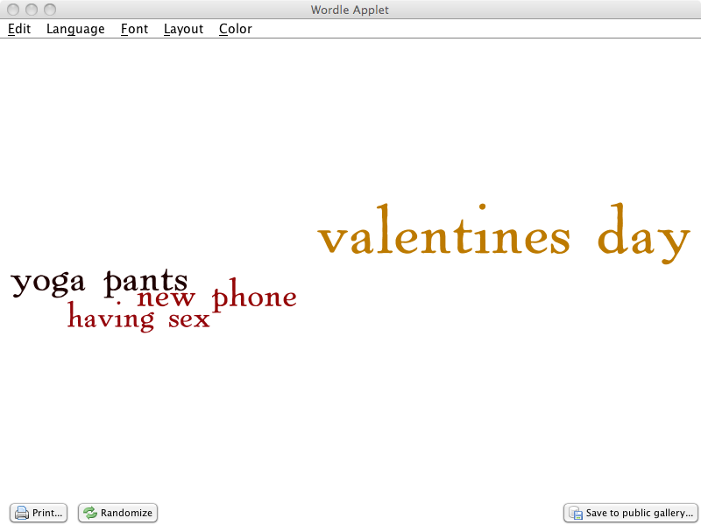
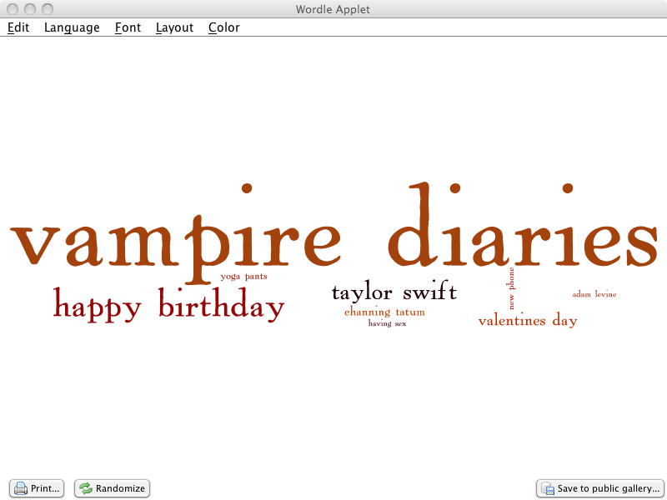
Location Based Filtering (we know where they lurk!)

Slide 17



Slide 18
Questions?
Concerned for your family and friends?
Office hours at 1:30 today, Expo Hall (Table E)
Signup for access to the data and see whether you are safe!
Email john.feland@argusinsights.com

